Slide 1


geecorn
login
password
Login

Slide 2

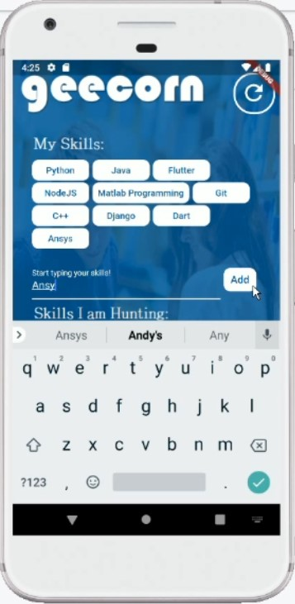
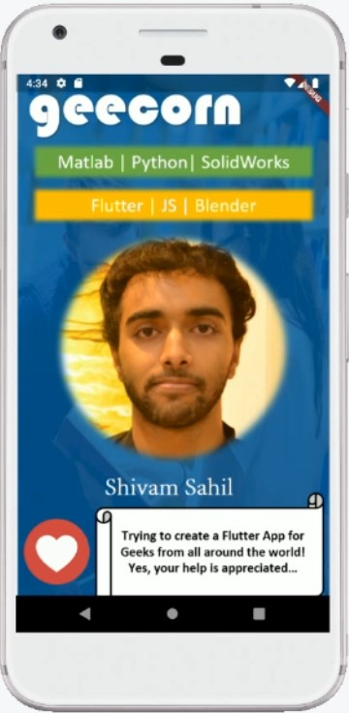
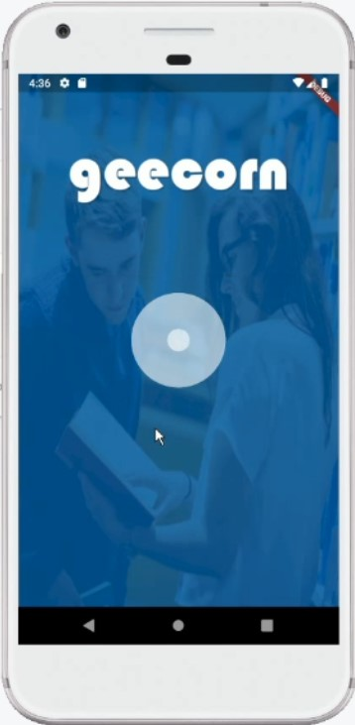
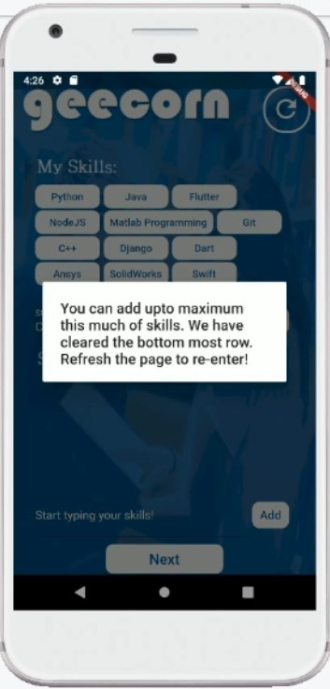
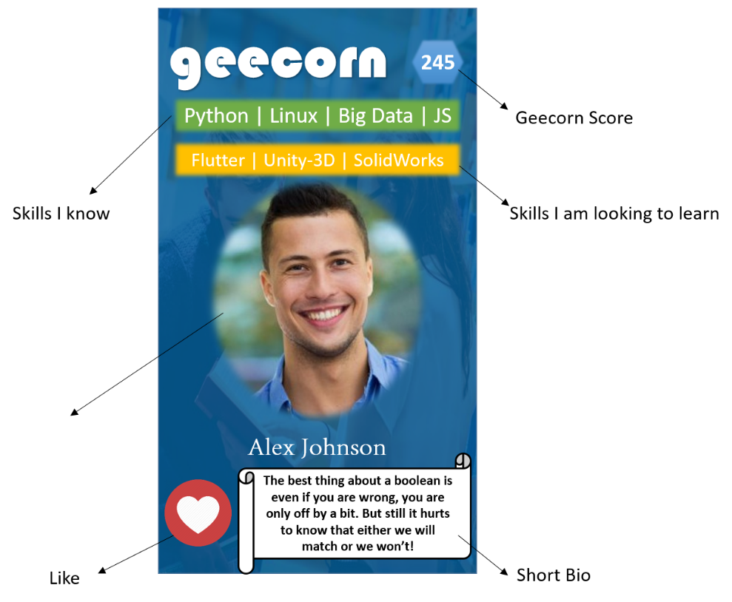
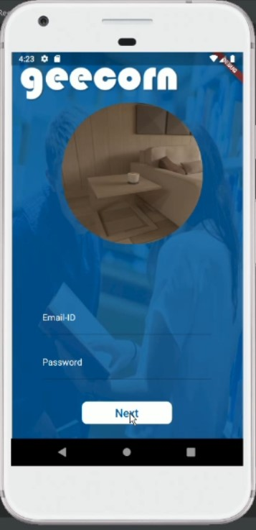
geecorn
The corner space for the geeks to enjoy and learn together and take full advantage of this covid lockdown…
login
password

Slide 3
geecorn
login
password
Login

Slide 4

geecorn
My Skills:
Discover Geeks
Skills I am Hunting:

Slide 5



geecorn
Start Swiping and
Discovering the geeks…

Slide 6


geecorn
245
Python | Linux | Big Data | JS
Geecorn Score
Flutter | Unity-3D | SolidWorks
Skills I know
Skills I am looking to learn
Alex Johnson
The best thing about a boolean is even if you are wrong, you are only off by a bit. But still it hurts to know that either we will match or we won’t!
Like
Short Bio

Slide 7
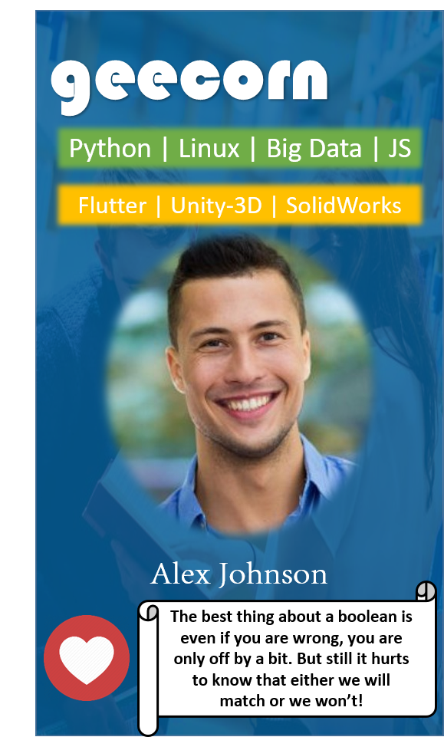
geecorn
Python | Linux | Big Data | JS
Flutter | Unity-3D | SolidWorks
Alex Johnson
The best thing about a boolean is even if you are wrong, you are only off by a bit. But still it hurts to know that either we will match or we won’t!

Slide 8
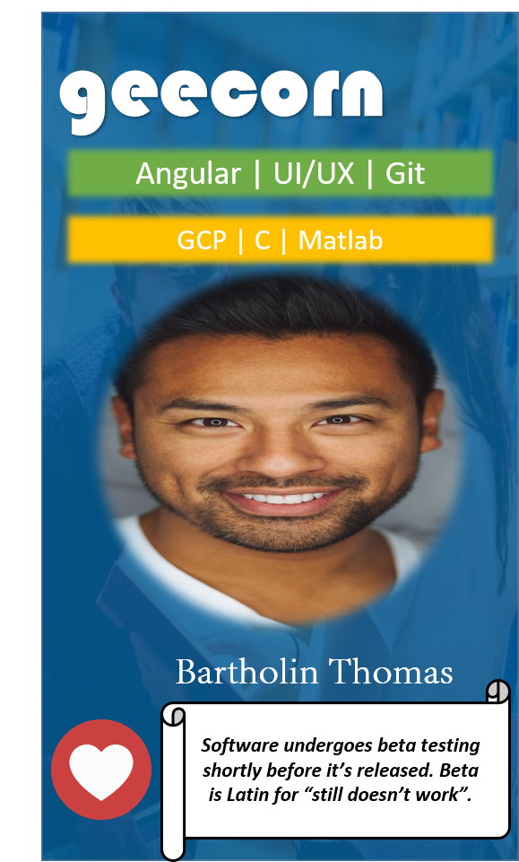

geecorn
Angular | UI/UX | Git
GCP | C | Matlab
Bartholin Thomas
Software undergoes beta testing shortly before it’s released. Beta is Latin for “still doesn’t work”.

Slide 9
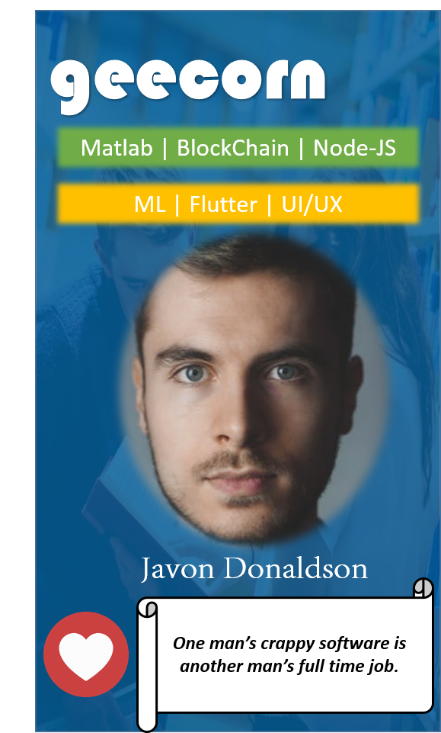

geecorn
Matlab | BlockChain | Node-JS
ML | Flutter | UI/UX
Javon Donaldson
One man’s crappy software is another man’s full time job.

Slide 10
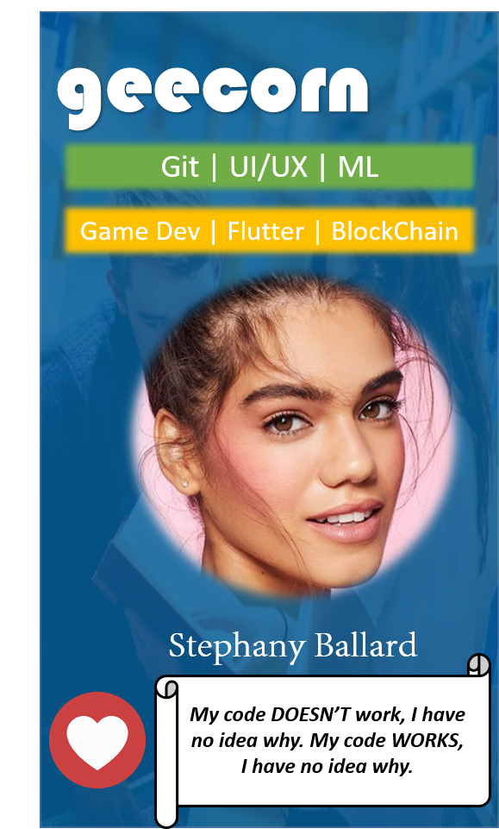

geecorn
Git | UI/UX | ML
Game Dev | Flutter | BlockChain
Stephany Ballard
My code DOESN’T work, I have no idea why. My code WORKS, I have no idea why.

Slide 11
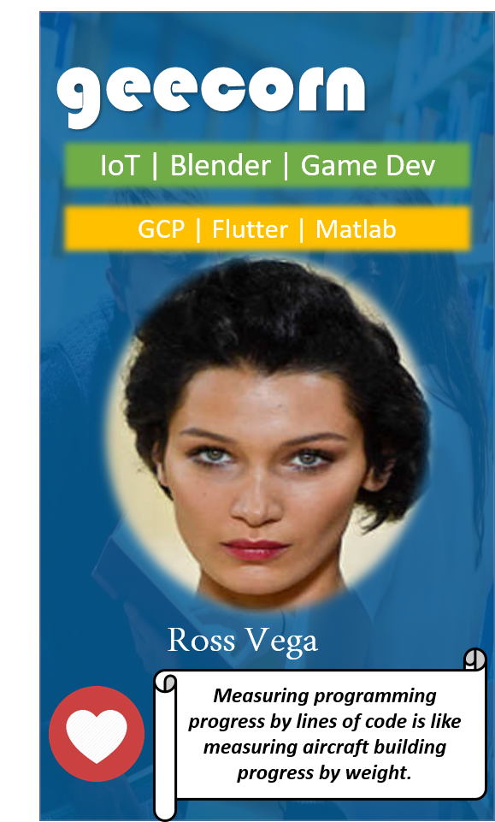

geecorn
IoT | Blender | Game Dev
GCP | Flutter | Matlab
Ross Vega
Measuring programming progress by lines of code is like measuring aircraft building progress by weight.

Slide 12
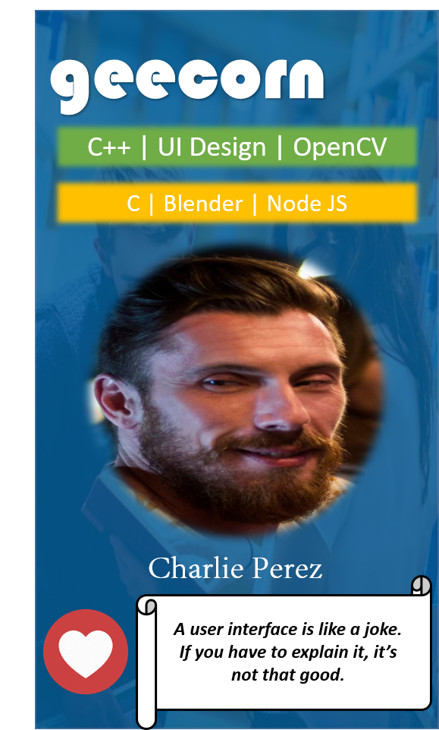

geecorn
C++ | UI Design | OpenCV
C | Blender | Node JS
Charlie Perez
A user interface is like a joke. If you have to explain it, it’s not that good.

Slide 13
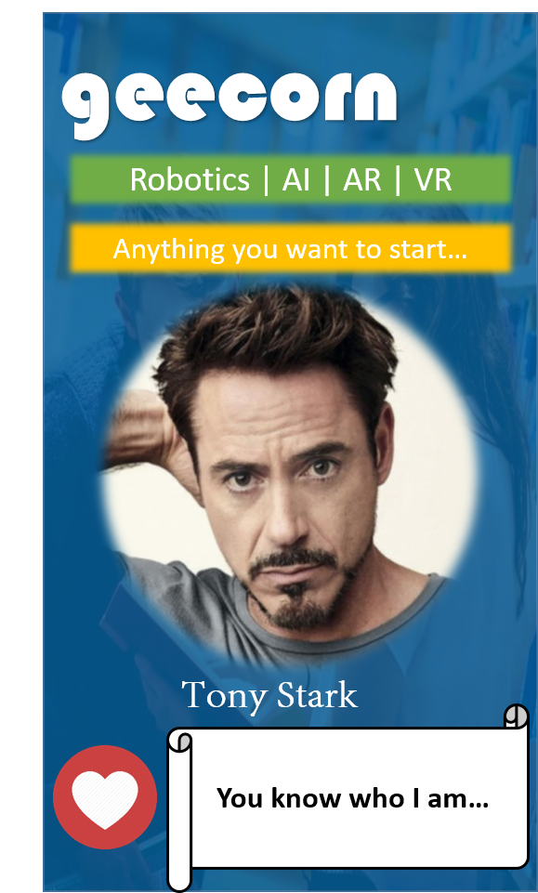

geecorn
Robotics | AI | AR | VR
Anything you want to start…
Tony Stark
You know who I am…

Slide 14
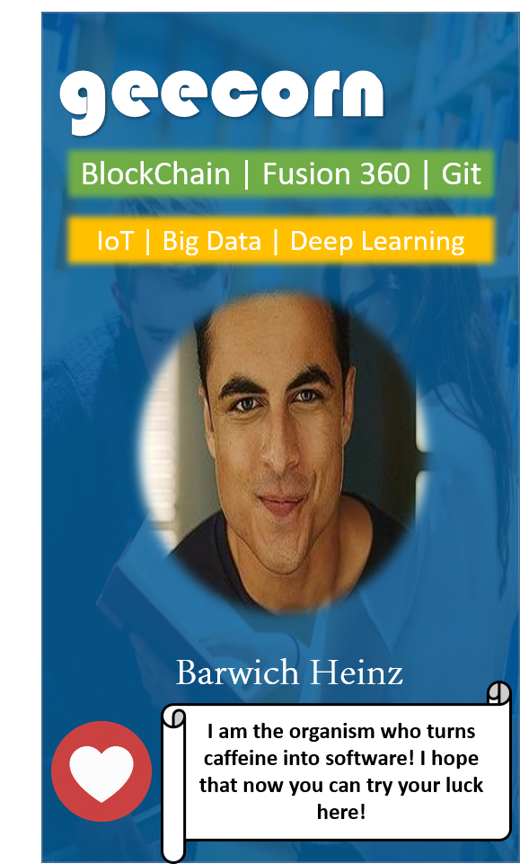

geecorn
BlockChain | Fusion 360 | Git
IoT | Big Data | Deep Learning
Barwich Heinz
I am the organism who turns caffeine into software! I hope that now you can try your luck here!

Slide 15
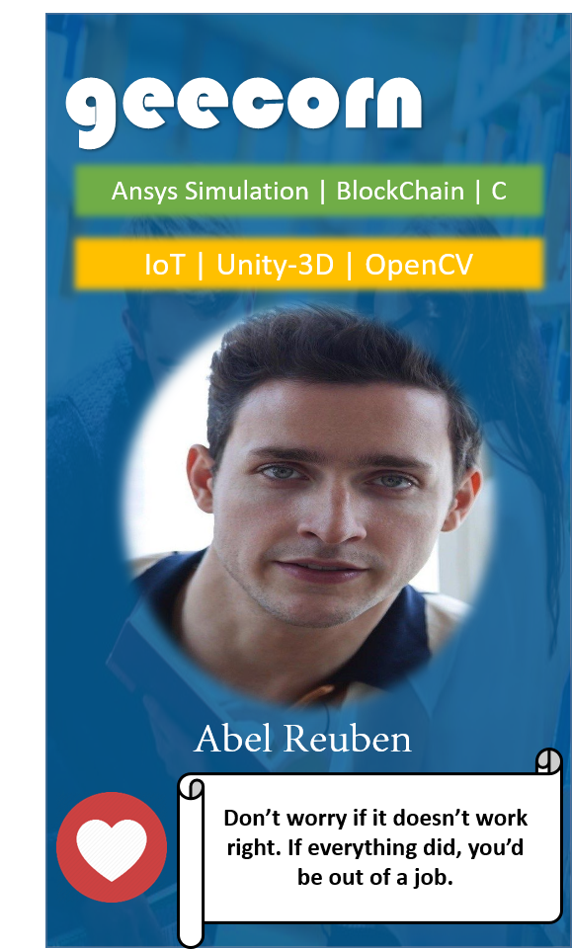

geecorn
Ansys Simulation | BlockChain | C
IoT | Unity-3D | OpenCV
Abel Reuben
Don’t worry if it doesn’t work right. If everything did, you’d be out of a job.

Slide 16
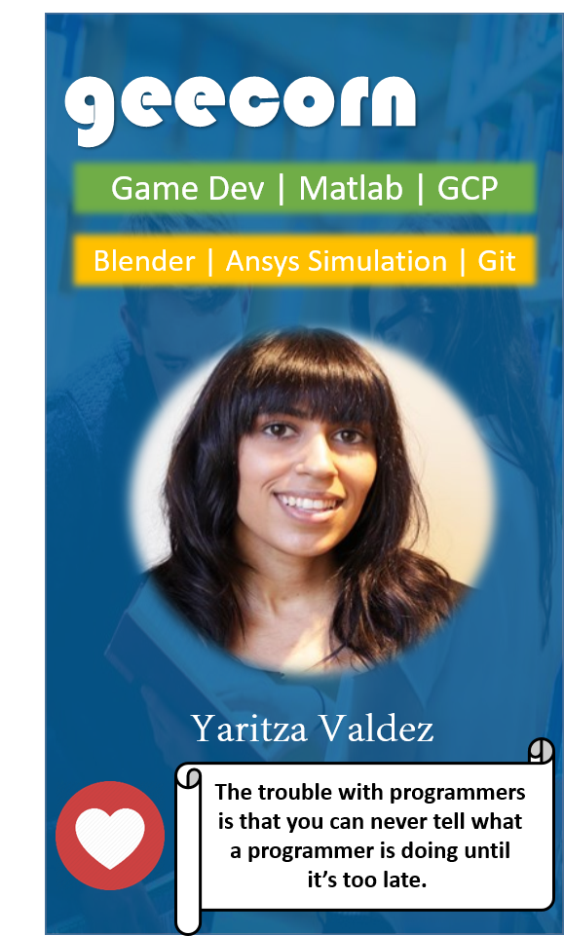

geecorn
Game Dev | Matlab | GCP
Blender | Ansys Simulation | Git
Yaritza Valdez
The trouble with programmers is that you can never tell what a programmer is doing until it’s too late.

Slide 17
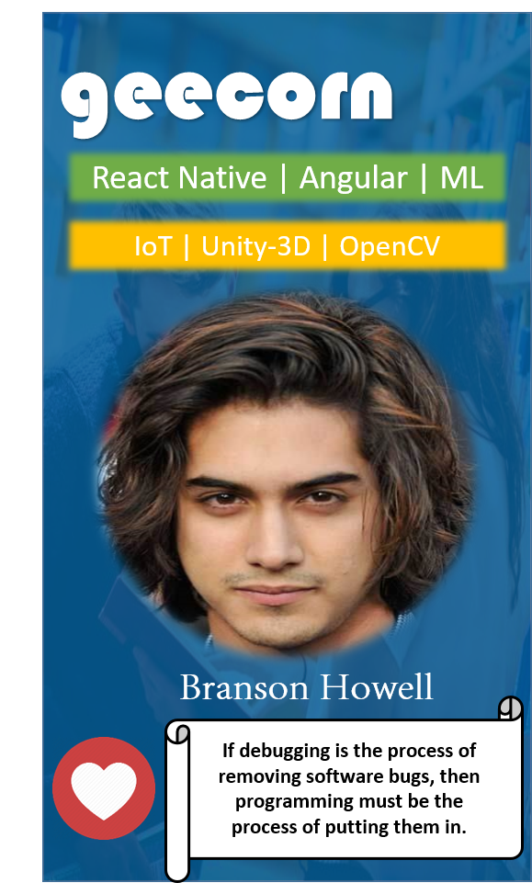

geecorn
React Native | Angular | ML
IoT | Unity-3D | OpenCV
Branson Howell
If debugging is the process of removing software bugs, then programming must be the process of putting them in.

Slide 18
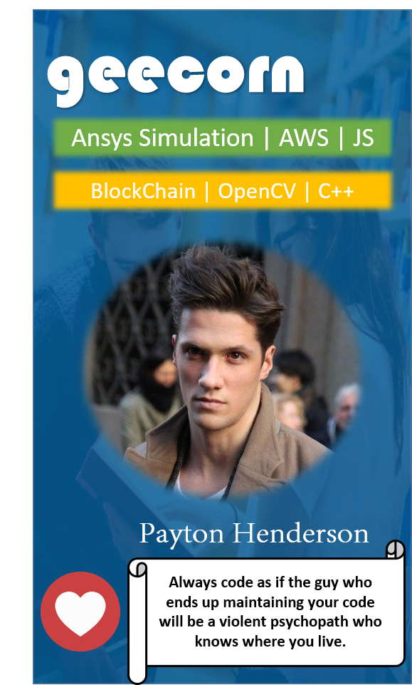

geecorn
Ansys Simulation | AWS | JS
BlockChain | OpenCV | C++
Payton Henderson
Always code as if the guy who ends up maintaining your code will be a violent psychopath who knows where you live.

Slide 19
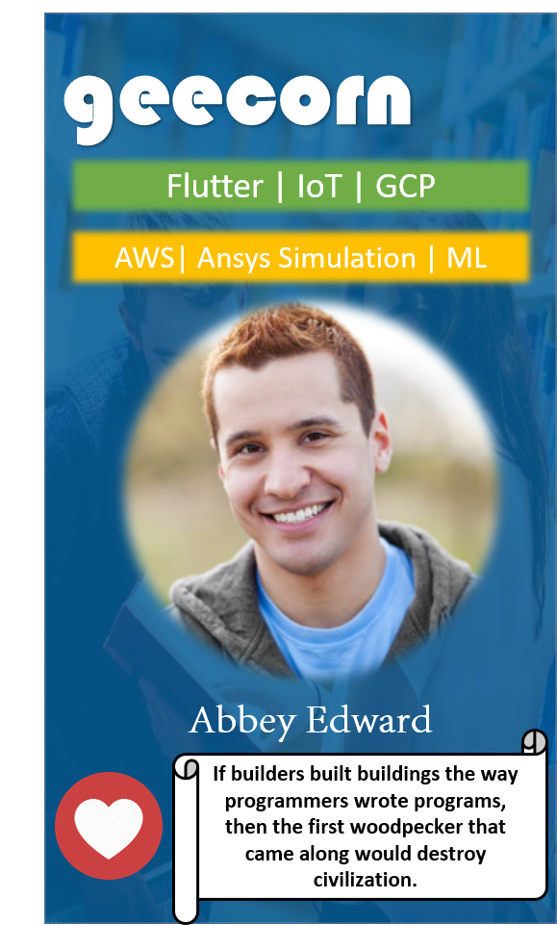

geecorn
Flutter | IoT | GCP
AWS| Ansys Simulation | ML
Abbey Edward
If builders built buildings the way programmers wrote programs, then the first woodpecker that came along would destroy civilization.

Slide 20
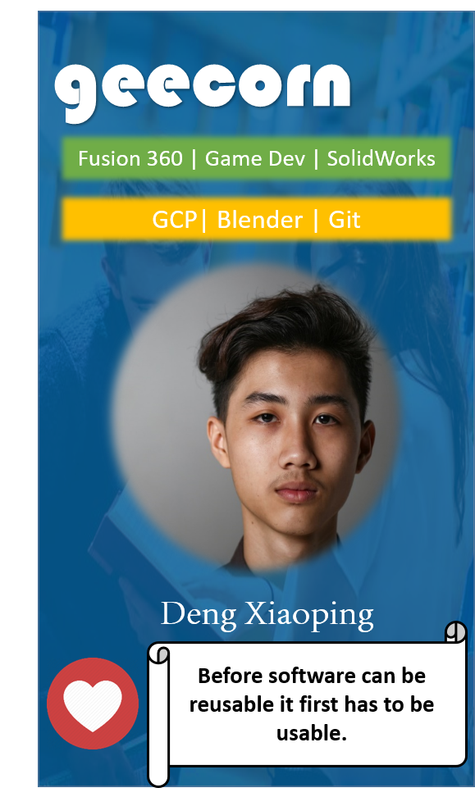

geecorn
Fusion 360 | Game Dev | SolidWorks
GCP| Blender | Git
Deng Xiaoping
Before software can be reusable it first has to be usable.

Slide 21
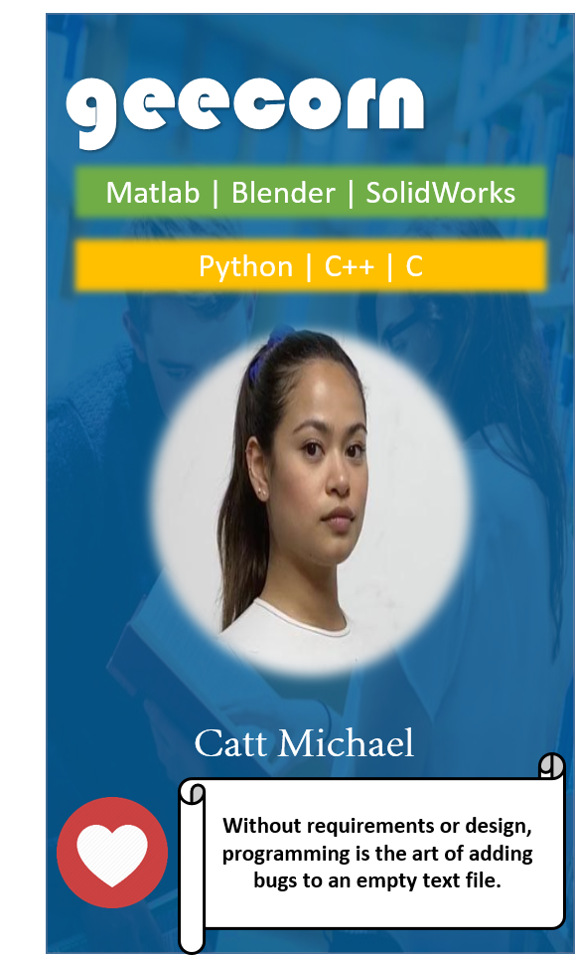

geecorn
Matlab | Blender | SolidWorks
Python | C++ | C
Catt Michael
Without requirements or design, programming is the art of adding bugs to an empty text file.

Slide 22
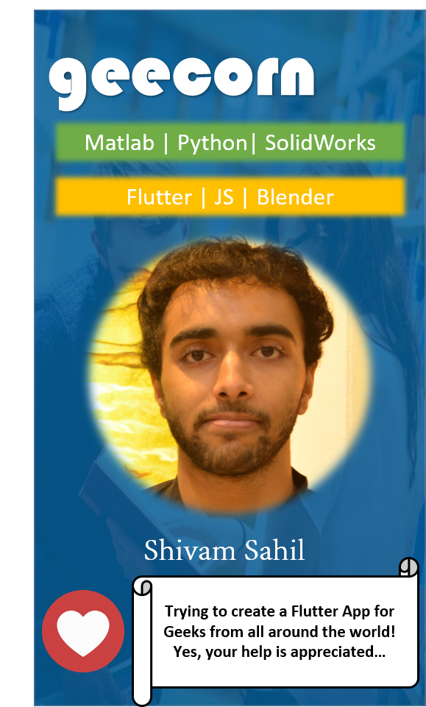

geecorn
Matlab | Python| SolidWorks
Flutter | JS | Blender
Shivam Sahil
Trying to create a Flutter App for Geeks from all around the world! Yes, your help is appreciated…

